Slide 1

Chapter 30
Cryptography
30.<number>
Copyright © The McGraw-Hill Companies, Inc. Permission required for reproduction or display.

Slide 2
30-1 INTRODUCTION
Let us introduce the issues involved in cryptography. First, we need to define some terms; then we give some taxonomies.
Topics discussed in this section:
Definitions
Two Categories
30.<number>

Slide 3
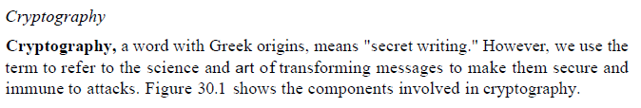
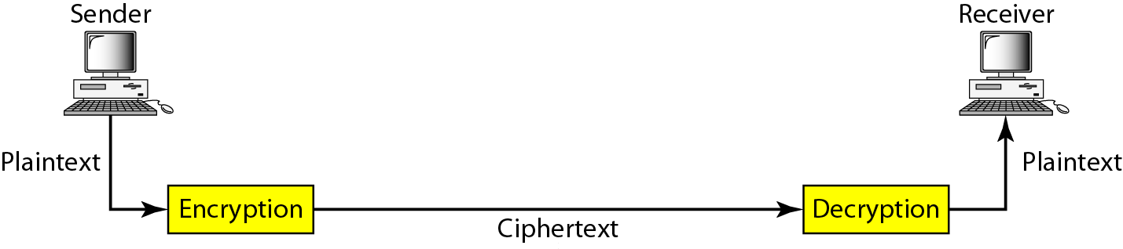
Figure 30.1 Cryptography components
30.<number>

Slide 4
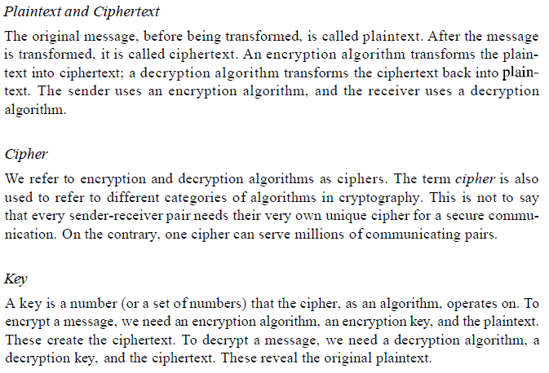
Figure 30.1 Cryptography components
30.<number>

Slide 5
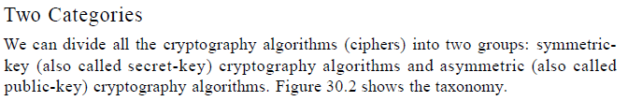
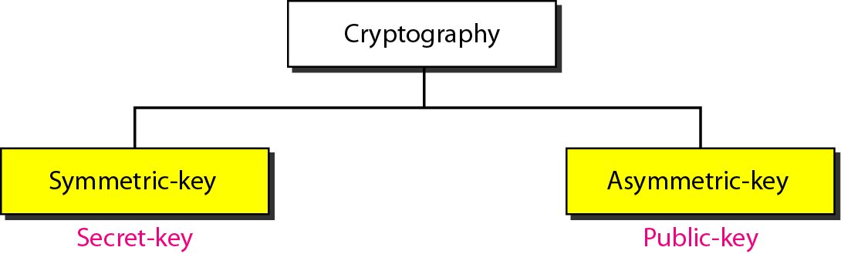
Figure 30.2 Categories of cryptography
30.<number>

Slide 6
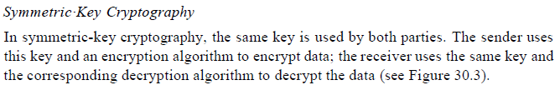
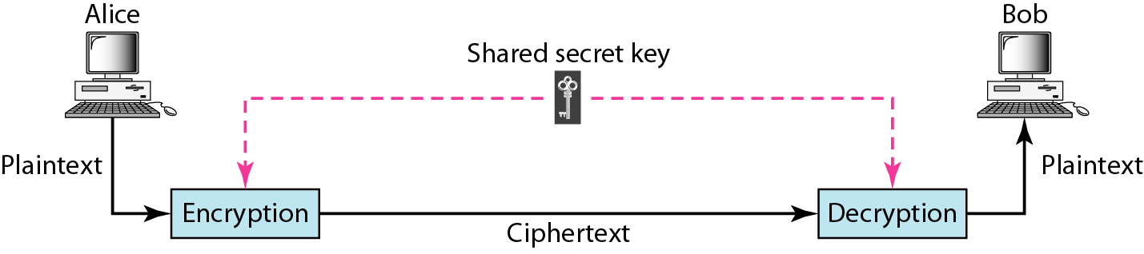
Figure 30.3 Symmetric-key cryptography
30.<number>

Slide 7

Note
In symmetric-key cryptography, the same key is used by the sender
(for encryption)
and the receiver (for decryption).
The key is shared.
30.<number>

Slide 8
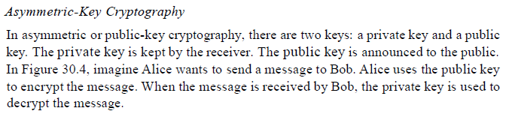
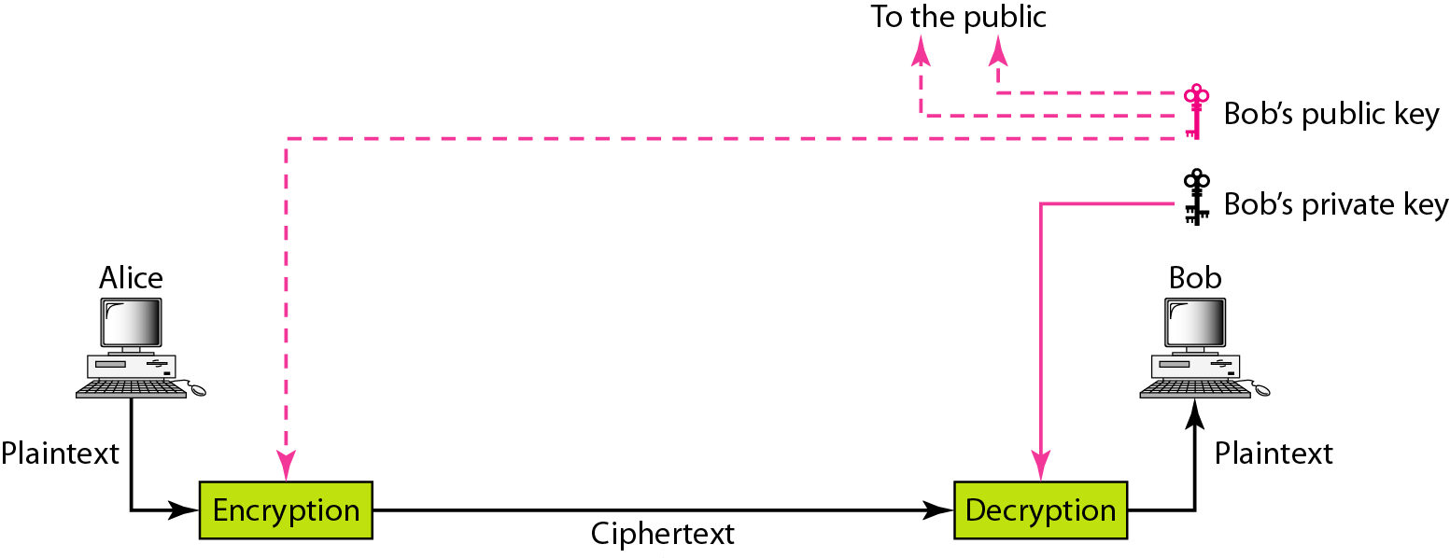
Figure 30.4 Asymmetric-key cryptography
30.<number>

Slide 9
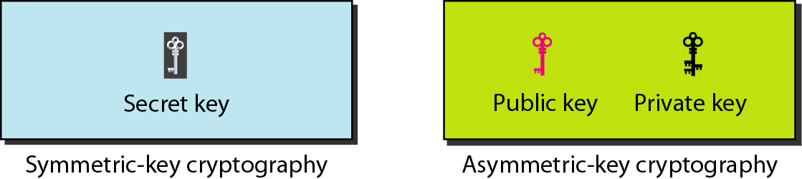
Figure 30.5 Keys used in cryptography
30.<number>

Slide 10
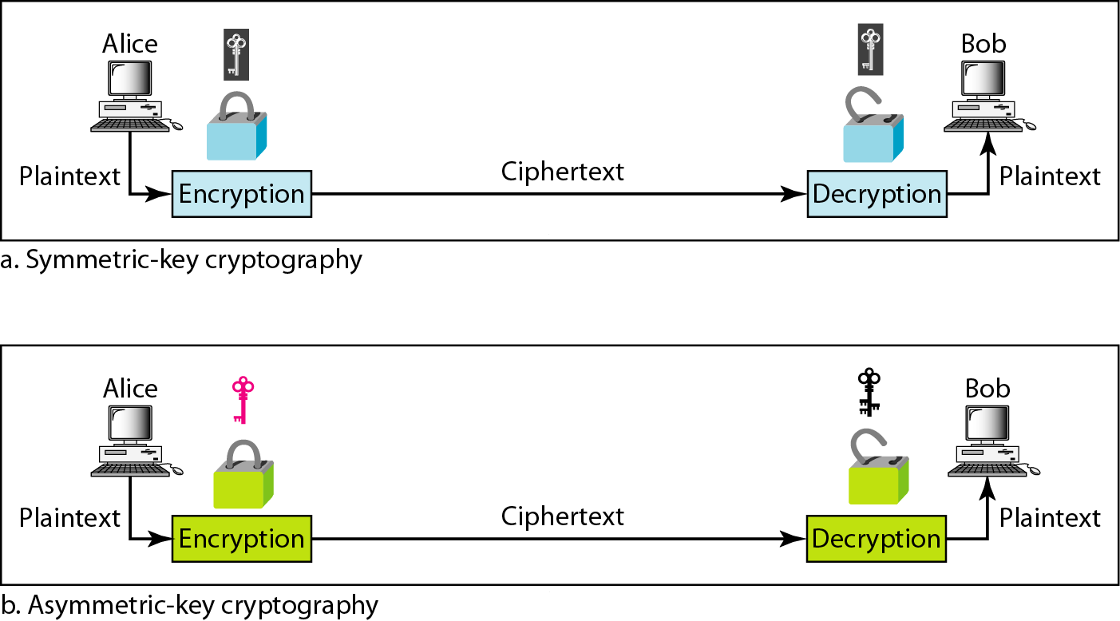
Figure 30.6 Comparison between two categories of cryptography
30.<number>

Slide 11
30-2 SYMMETRIC-KEY CRYPTOGRAPHY
Symmetric-key cryptography started thousands of years ago when people needed to exchange secrets (for example, in a war). We still mainly use symmetric-key cryptography in our network security. However, today’s ciphers are much more complex.
Topics discussed in this section:
Traditional Ciphers
Simple Modern Ciphers
Modern Round Ciphers
Mode of Operation
30.<number>

Slide 12
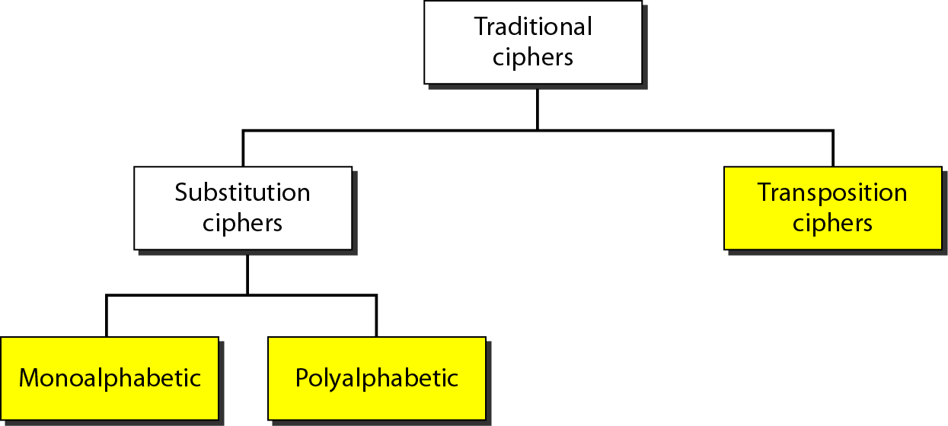
Figure 30.7 Traditional ciphers
30.<number>

Slide 13
Note
A substitution cipher replaces one symbol with another.
30.<number>

Slide 14
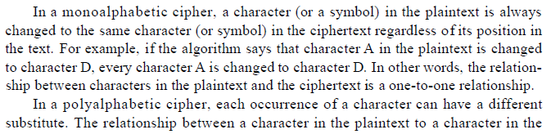
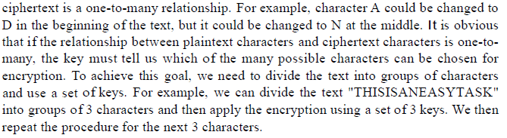
30.<number>

Slide 15
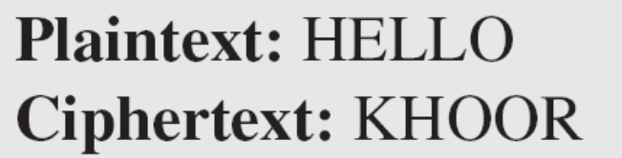
Example 30.1
The following shows a plaintext and its corresponding ciphertext. Is the cipher monoalphabetic?
Solution
The cipher is probably monoalphabetic because both occurrences of L’s are encrypted as O’s.
30.<number>

Slide 16
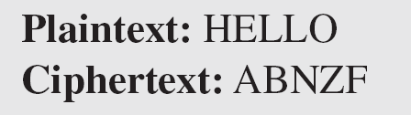
Example 30.2
The following shows a plaintext and its corresponding ciphertext. Is the cipher monoalphabetic?
Solution
The cipher is not monoalphabetic because each occurrence of L is encrypted by a different character. The first L is encrypted as N; the second as Z.
30.<number>

Slide 17
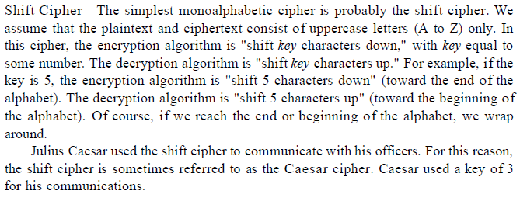
The shift cipher is sometimes referred to as the Caesar cipher.
30.<number>

Slide 18
Example 30.3
Use the shift cipher with key = 15 to encrypt the message “HELLO.”
Solution
We encrypt one character at a time. Each character is shifted 15 characters down. Letter H is encrypted to W. Letter E is encrypted to T. The first L is encrypted to A. The second L is also encrypted to A. And O is encrypted to D. The cipher text is WTAAD.
30.<number>

Slide 19
Example 30.4
Use the shift cipher with key = 15 to decrypt the message “WTAAD.”
Solution
We decrypt one character at a time. Each character is shifted 15 characters up. Letter W is decrypted to H. Letter T is decrypted to E. The first A is decrypted to L. The second A is decrypted to L. And, finally, D is decrypted to O. The plaintext is HELLO.
30.<number>

Slide 20
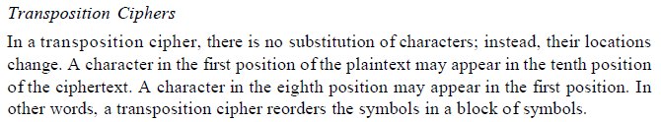
A transposition cipher reorders (permutes) symbols in a block of symbols.
30.<number>

Slide 21
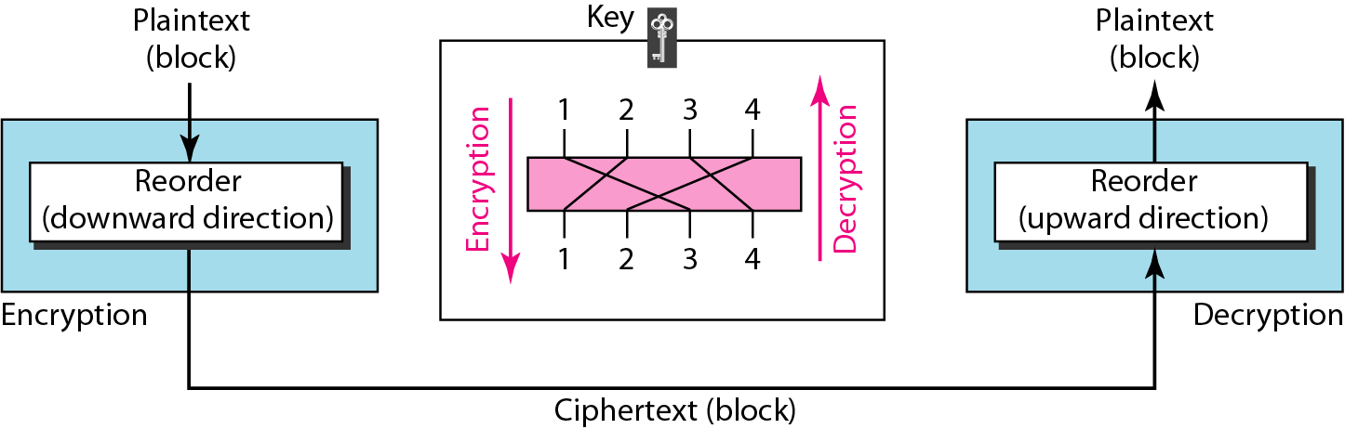
Figure 30.8 Transposition cipher
30.<number>

Slide 22
Example 30.5
Encrypt the message “HELLO MY DEAR,” using the key shown in Figure 30.8.
Solution
We first remove the spaces in the message. We then divide the text into blocks of four characters. We add a bogus character Z at the end of the third block. The result is HELL OMYD EARZ. We create a three-block ciphertext ELHLMDOYAZER.
30.<number>

Slide 23
Example 30.6
Using Example 30.5, decrypt the message “ELHLMDOYAZER”.
Solution
The result is HELL OMYD EARZ. After removing the bogus character and combining the characters, we get the original message “HELLO MY DEAR.”
30.<number>

Slide 24
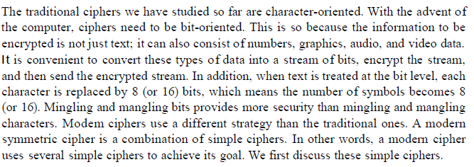
Simple Modern Ciphers
30.<number>

Slide 25
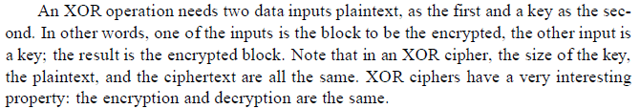
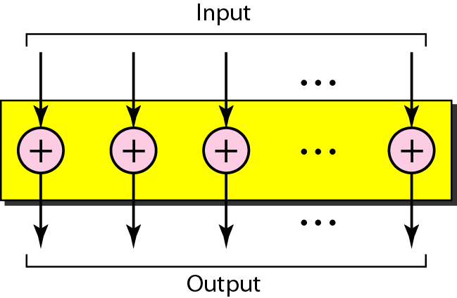
Figure 30.9 XOR cipher
30.<number>

Slide 26
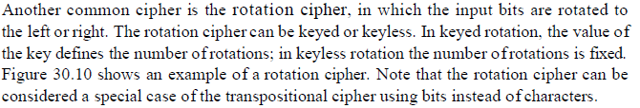
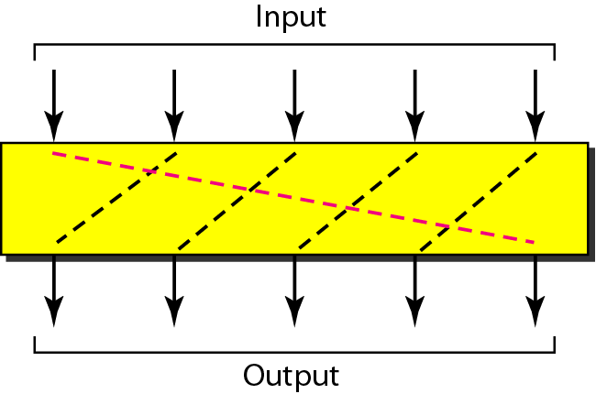
Figure 30.10 Rotation cipher
30.<number>

Slide 27
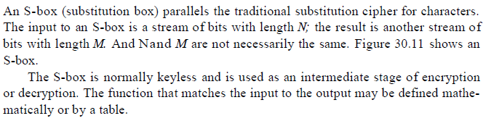
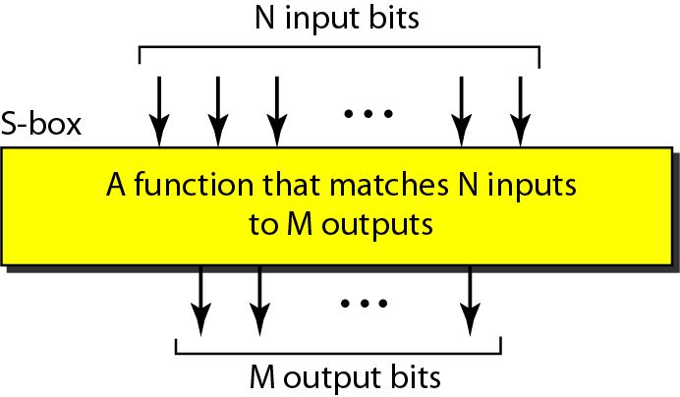
Figure 30.11 S-box
30.<number>

Slide 28

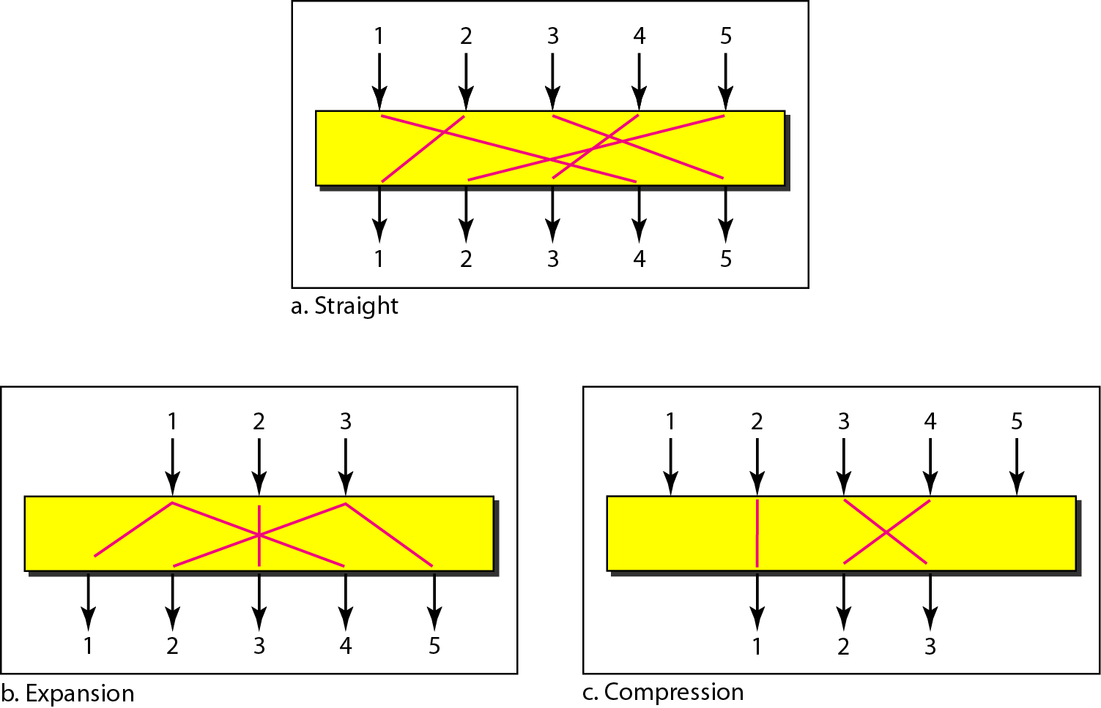
Figure 30.12 P-boxes: straight, expansion, and compression
30.<number>

Slide 29
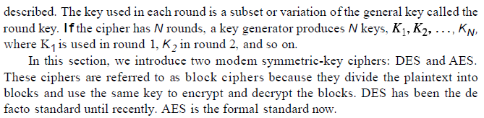
Modern Round Ciphers
30.<number>

Slide 30

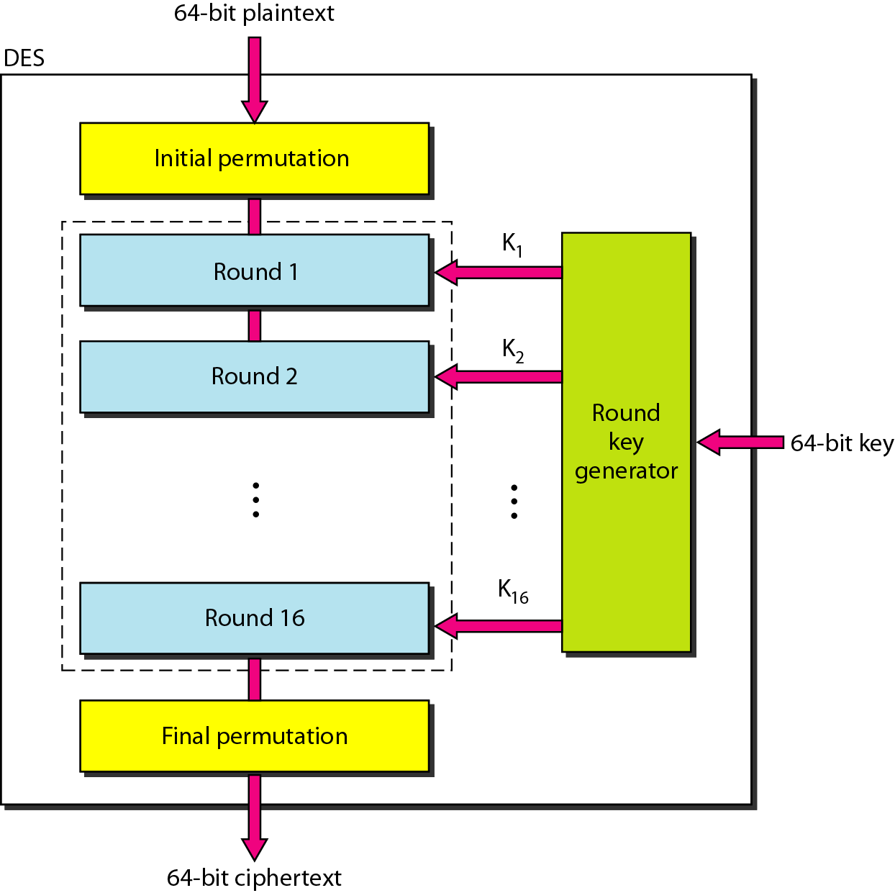
Figure 30.13 DES
30.<number>

Slide 31
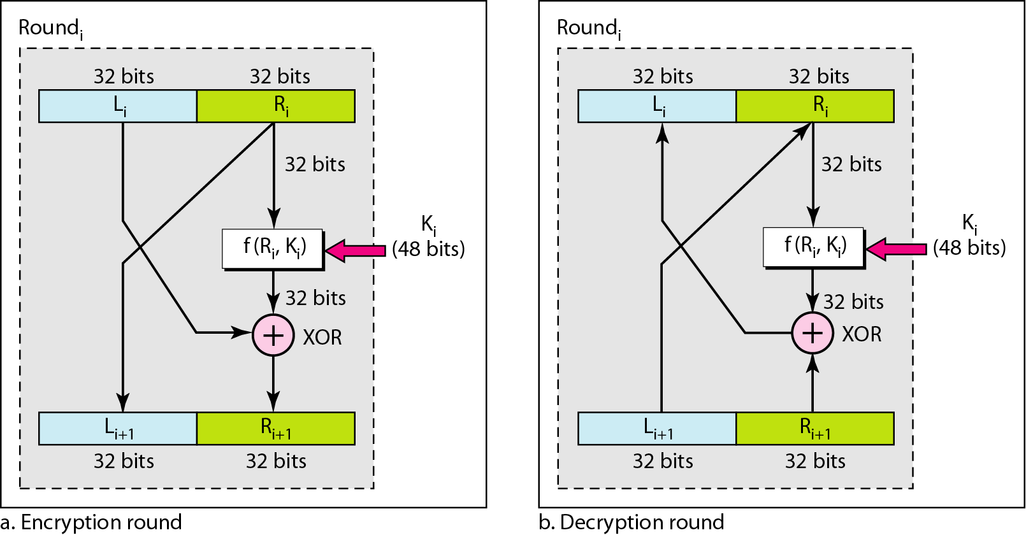
Figure 30.14 One round in DES ciphers
30.<number>

Slide 32
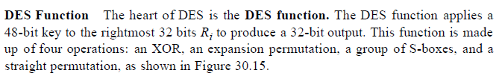
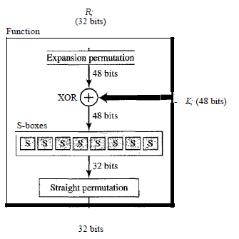
Figure 30.15 DES function
30.<number>

Slide 33
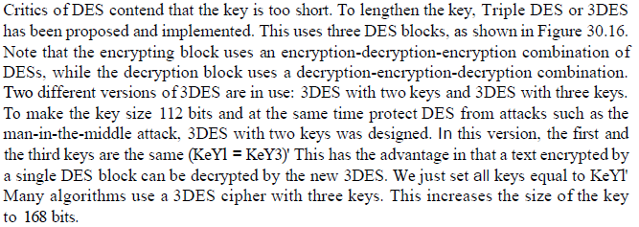
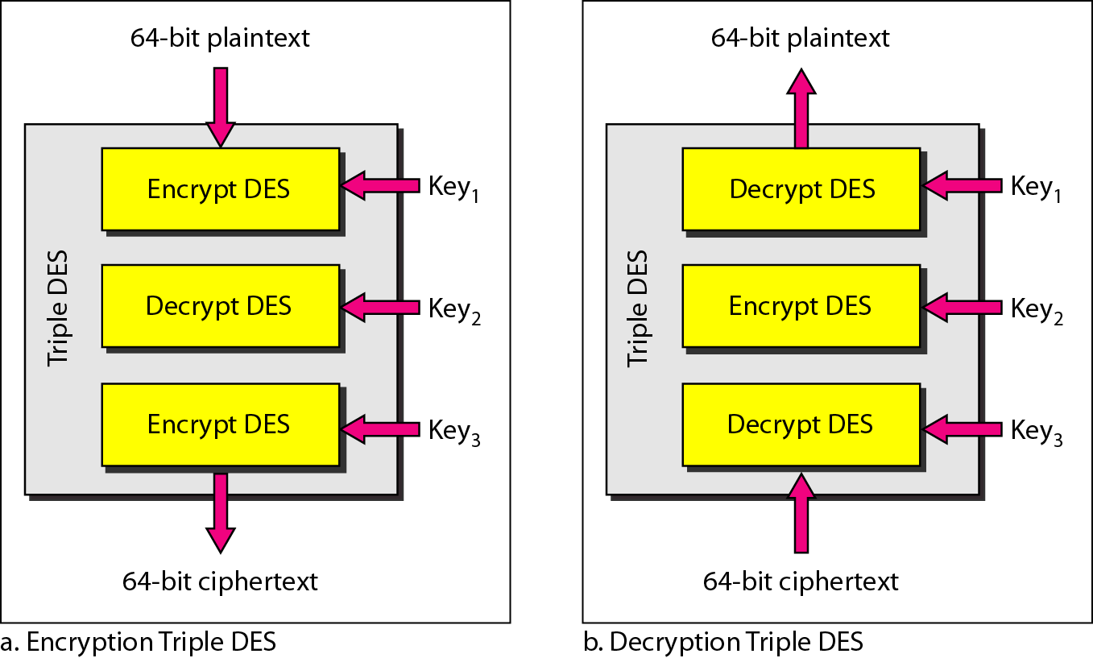
Figure 30.16 Triple DES
30.<number>

Slide 34
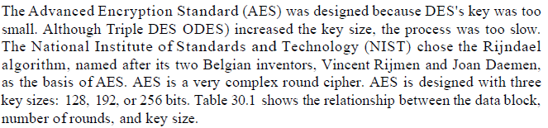
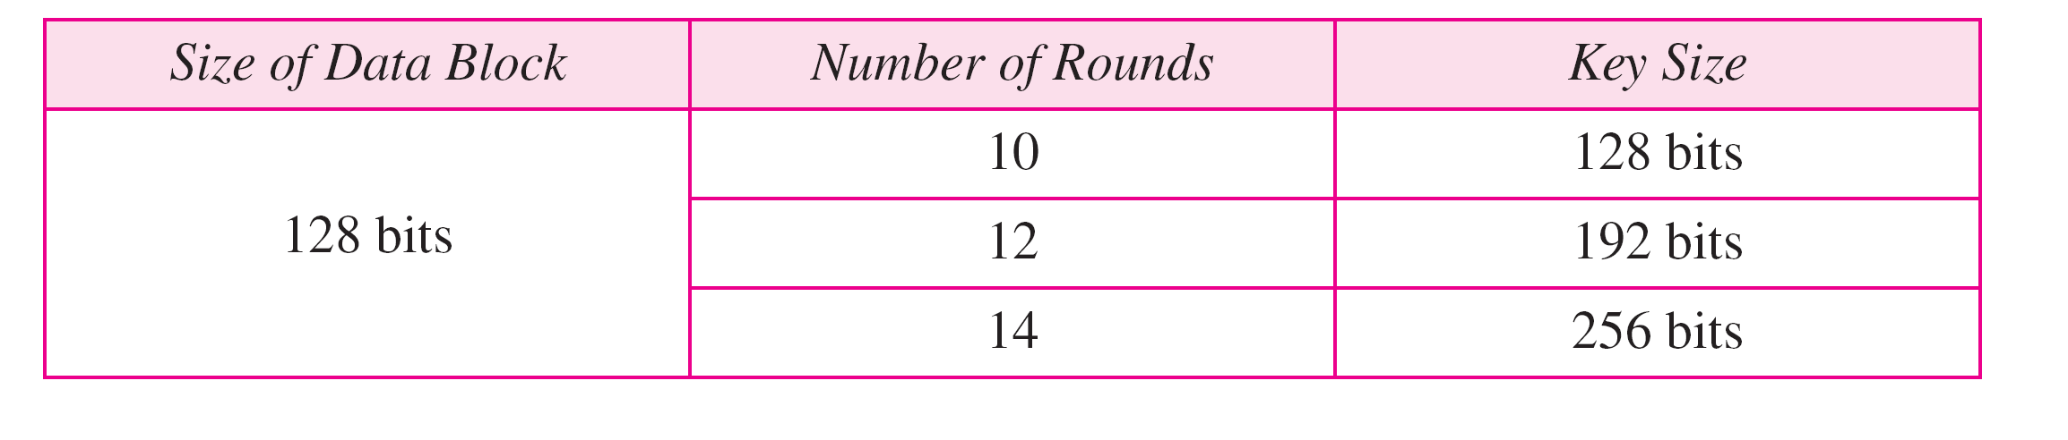
Table 30.1 AES configuration
30.<number>

Slide 35
Note
AES has three different configurations with respect to the number of rounds and key size.
30.<number>

Slide 36
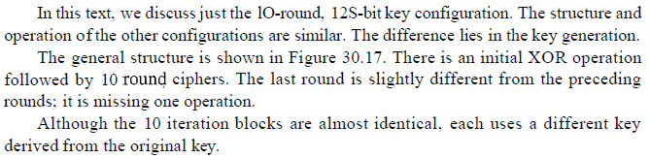
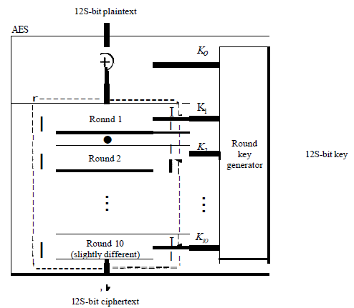
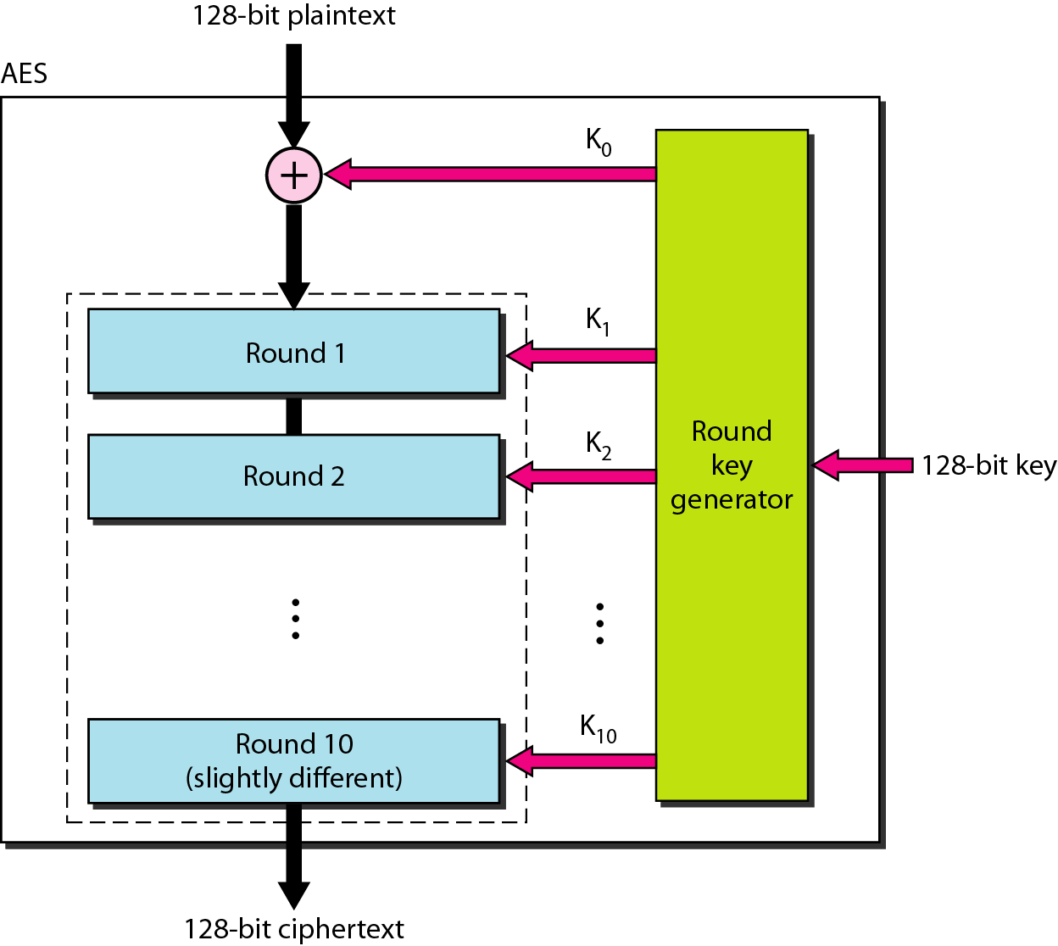
Figure 30.17 AES
30.<number>

Slide 37

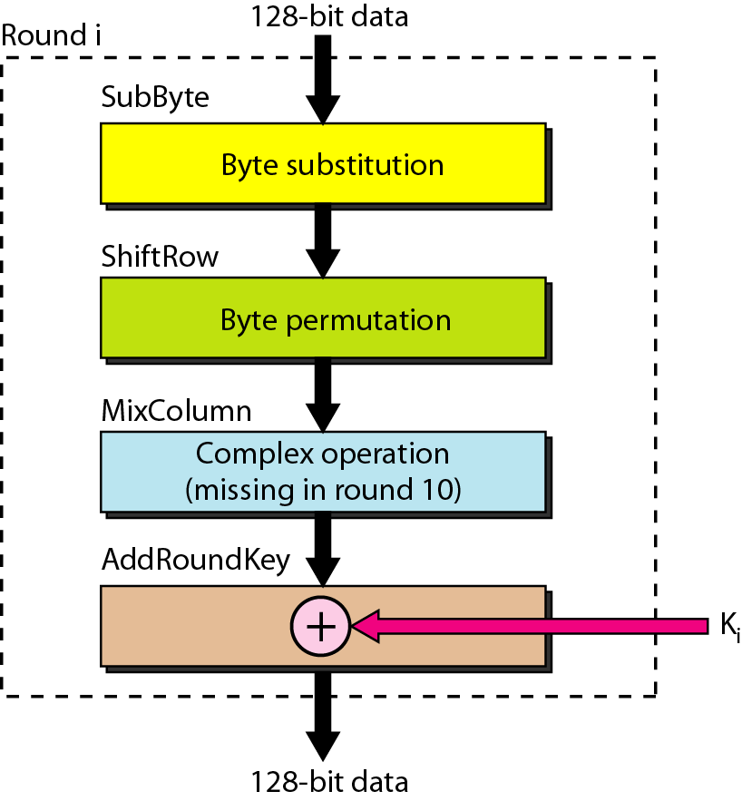
Figure 30.18 Structure of each round
30.<number>

Slide 38
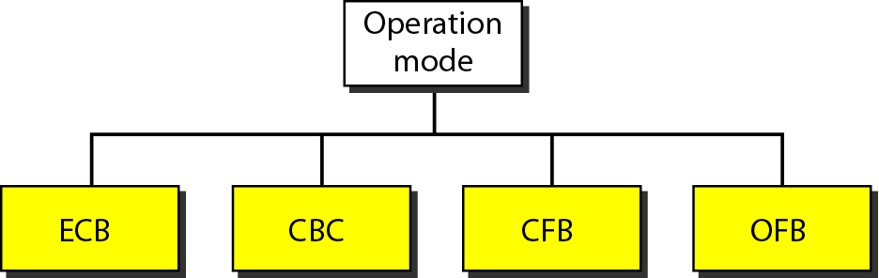
Figure 30.19 Modes of operation for block ciphers
30.<number>

Slide 39

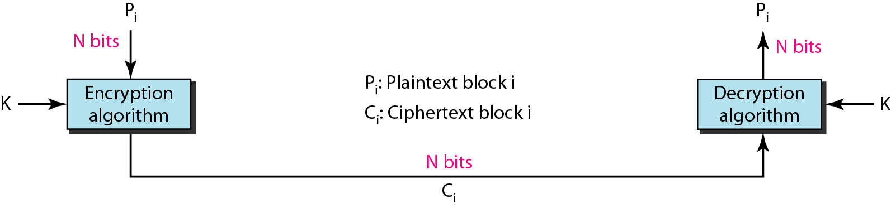
Figure 30.20 Electronic Code Book mode (ECB)
30.<number>

Slide 40
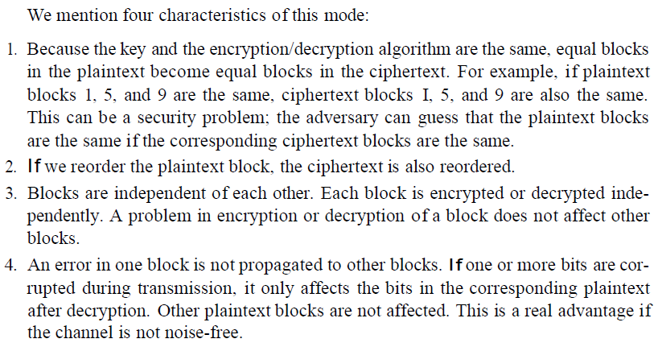
Figure 30.20 Electronic Code Book mode (ECB)
30.<number>

Slide 41
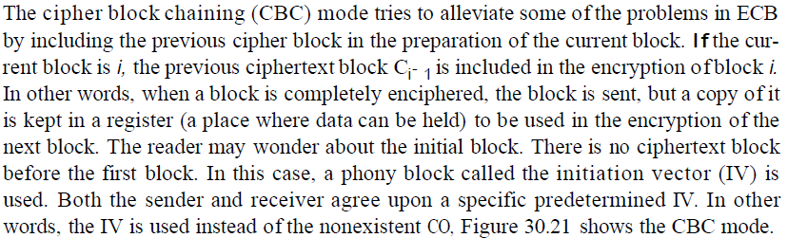
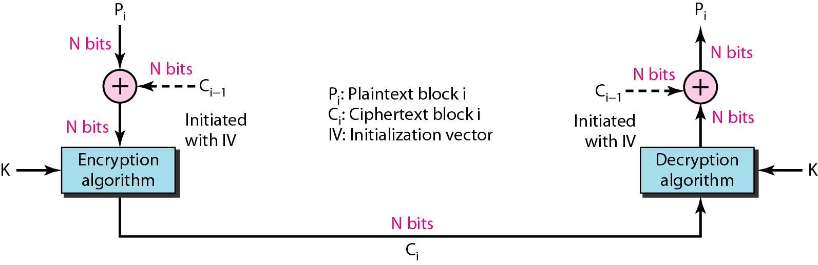
Figure 30.21 Cipher Block Chaining mode (CBC)
30.<number>

Slide 42
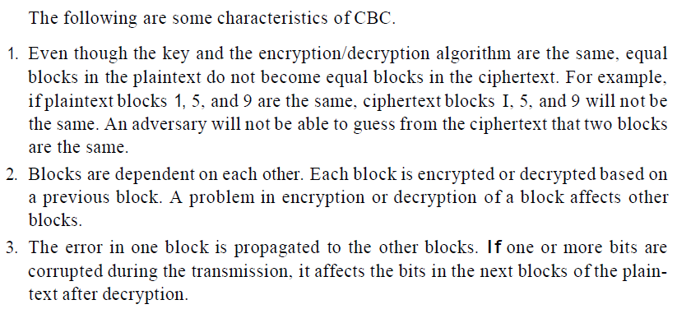
Figure 30.21 Cipher Block Chaining mode (CBC)
30.<number>

Slide 43
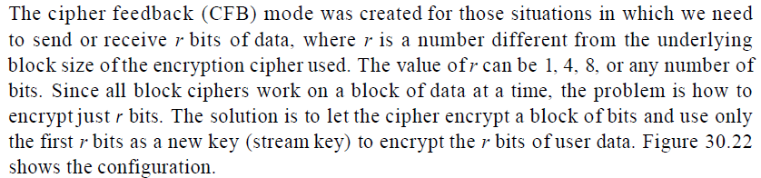
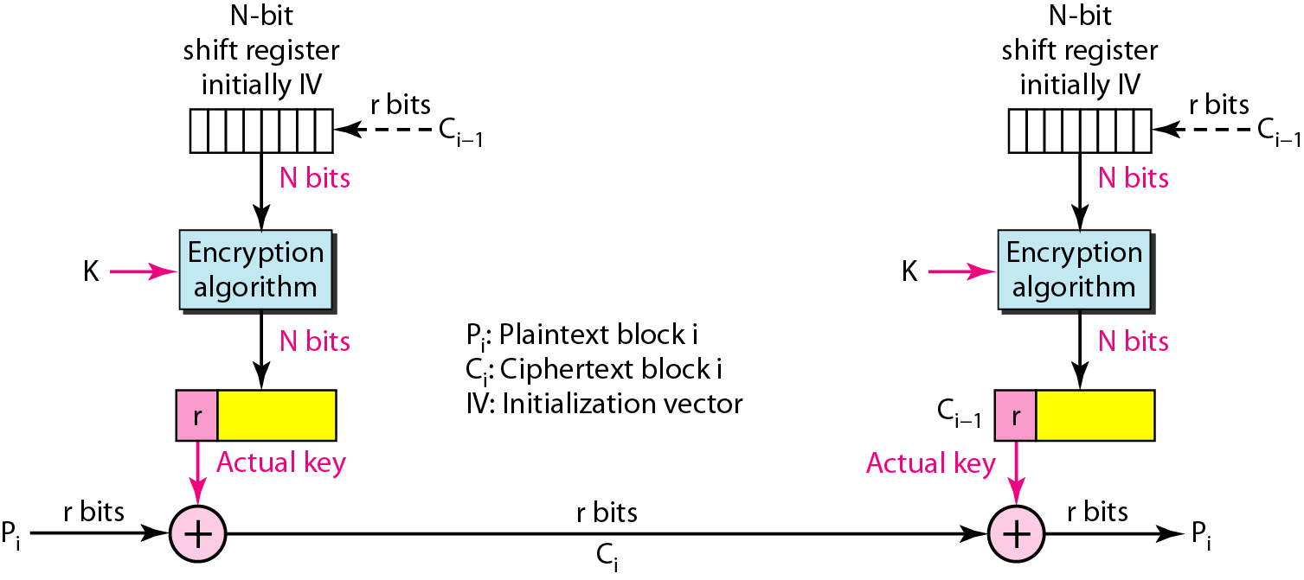
Figure 30.22 Cipher FeedBack mode (CFB)
30.<number>

Slide 44
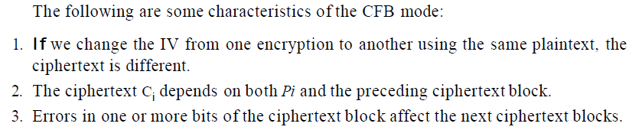
Figure 30.22 Cipher FeedBack mode (CFB)
30.<number>

Slide 45
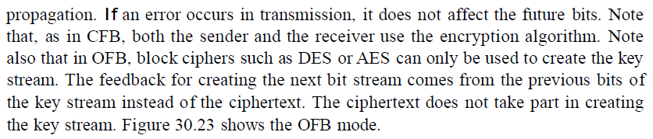

Figure 30.23 Output FeedBack mode (OFB)
30.<number>

Slide 46

Figure 30.23 Output FeedBack mode (OFB)
30.<number>

Slide 47
30-3 ASYMMETRIC-KEY CRYPTOGRAPHY
An asymmetric-key (or public-key) cipher uses two keys: one private and one public. We discuss two algorithms: RSA and Diffie-Hellman.
Topics discussed in this section:
RSA
Diffie-Hellman
30.<number>

Slide 48


Figure 30.24 Rivest Shamir Adleman (RSA)
30.<number>

Slide 49

In RSA, e and n are announced to the public; d and Φ are kept secret.
30.<number>

Slide 50

30.<number>

Slide 51

30.<number>

Slide 52

Example 30.7
Bob chooses 7 and 11 as p and q and calculates
n = 7 x 11 = 77. The value of Φ = (7 − 1) (11 − 1) or 60. Now he chooses two keys, e and d. If he chooses e to be 13, then d is 37. Now imagine Alice sends the plaintext 5 to Bob. She uses the public key 13 to encrypt 5.
30.<number>

Slide 53

Example 30.7 (continued)
Bob receives the ciphertext 26 and uses the private key 37 to decipher the ciphertext:
The plaintext 5 sent by Alice is received as plaintext 5 by Bob.
30.<number>

Slide 54


30.<number>

Slide 55
Note
The symmetric (shared) key in the
Diffie-Hellman protocol is
K = g^{xy} mod p.
30.<number>

Slide 56

Procedure
30.<number>

